Slide 1

Fantasy Barclays Premier League Weekly Starting Lineup Optimization
December 2nd 2015

Slide 2
GROUP MEMBERS
NagaShrikanth Ammamanabrolu
Nikhil Soman
Adwait Deshpande
Vidit Brahmankar
Kislay Kumar Rai

Slide 3
WHAT IS FANTASY SPORTS?
Fantasy Sport is a virtual game environment where participants assemble virtual teams of real players of a professional sport.
The player performance is converted into points that are compiled and totaled according to a roster selected by each fantasy team's manager.
Fantasy Sports Trade Association estimates 56.8 Million people over age 12 have played Fantasy Sport in the US & Canada in 2015.
Source: FSTA.org

Slide 4
FANTASY BARCLAYS PREMIER LEAGUE
Fantasy Barclays Premier League is the leading fantasy sports provider in the UK with 3 million users.
Winning 1st Prize of the Fantasy league offers £25,000, and other monthly & quarterly prizes.
A fantasy team is pitted against 3 Million other fantasy teams for the top spot, and individual leagues can also be created.

Slide 5
DATA COLLECTION
The official website of the Fantasy Barclays Premier League at fantasy.premierleague.com has been used to collect the data.
The data used for this project is for the initial 12 games played out of 38 in the current 2015-16 season.

Slide 6

PROJECT OBJECTIVE
To pick an optimum mix of starting 11 players, maximizing the weekly points, while not extending the budget constraints.

Slide 7
PROBLEM FORMULATION
Variables:
700 Fantasy players, across 20 different teams.
Constraints:
Total budget must not exceed £100 million.
There must be a total of 15 players.
2 Goalkeepers
5 Defenders
5 Midfielders
2 Strikers
Not more than 3 players must be selected from a single team.

Slide 8
PROJECT WORKFLOW
A total of 700 players are selected.
Due to the limitations of Excel Solver, top 200 players from each of the four positions are selected.
The top 15 players are selected by considering the previously mentioned constraints.
The constraints for the Starting 11 team are as follows:
Exactly 1 Goalkeeper
At least 3 Defenders
At least 1 Forward

Slide 9
METHODOLOGY
Player Performance Index (PPI)
The Player Performance Index is determined by calculating the cost per point, from the points accrued until now and the player’s cost in the market.
The player with the least cost per point are considered into the starting lineup.

Slide 10
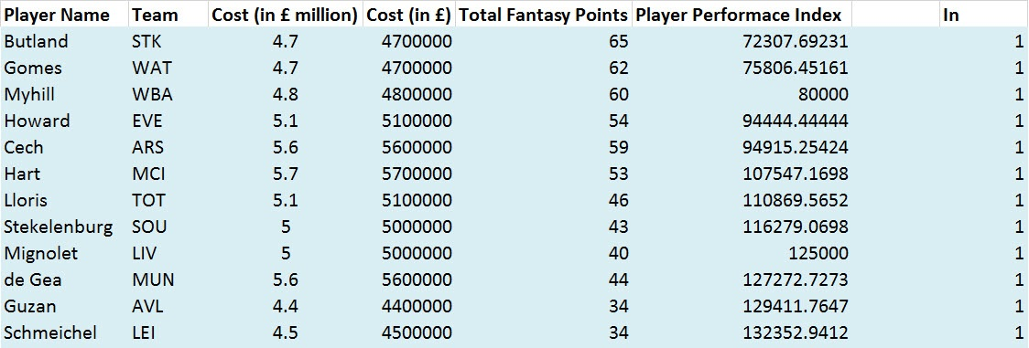
METHODOLOGY
Goalkeepers
10 Top Goalkeepers out of 61 total Goalkeepers have been selected.

Slide 11
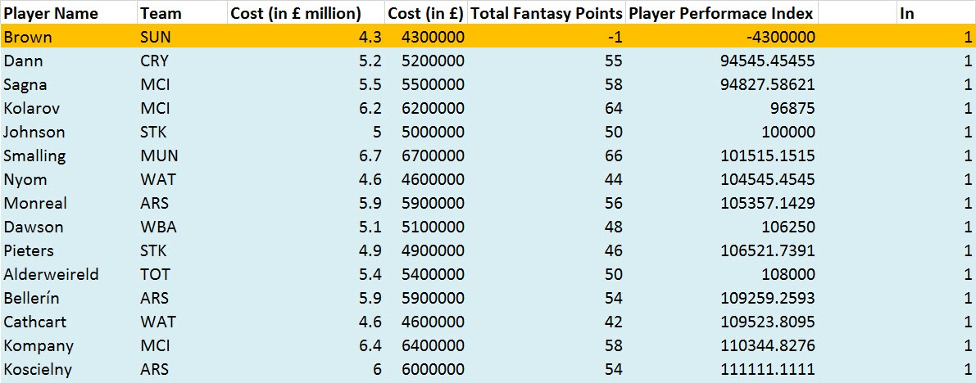
METHODOLOGY
Defenders
90 Top Defenders out of 181 total Defenders have been selected.

Slide 12
METHODOLOGY
Midfielders
70 Top Defenders out of 181 total Defenders have been selected.

Slide 13
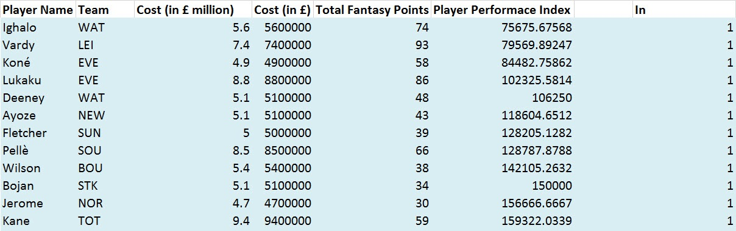
METHODOLOGY
Forwards
30 Top Forwards out of 93 total Forwards have been selected.

Slide 14
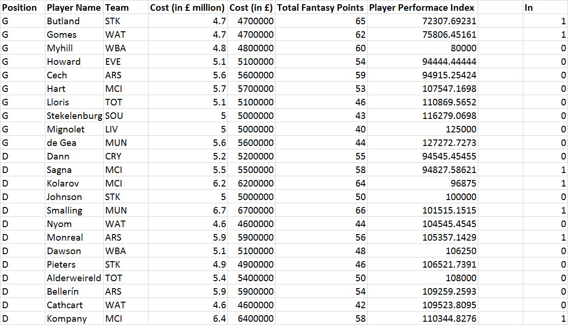
METHODOLOGY

Slide 15
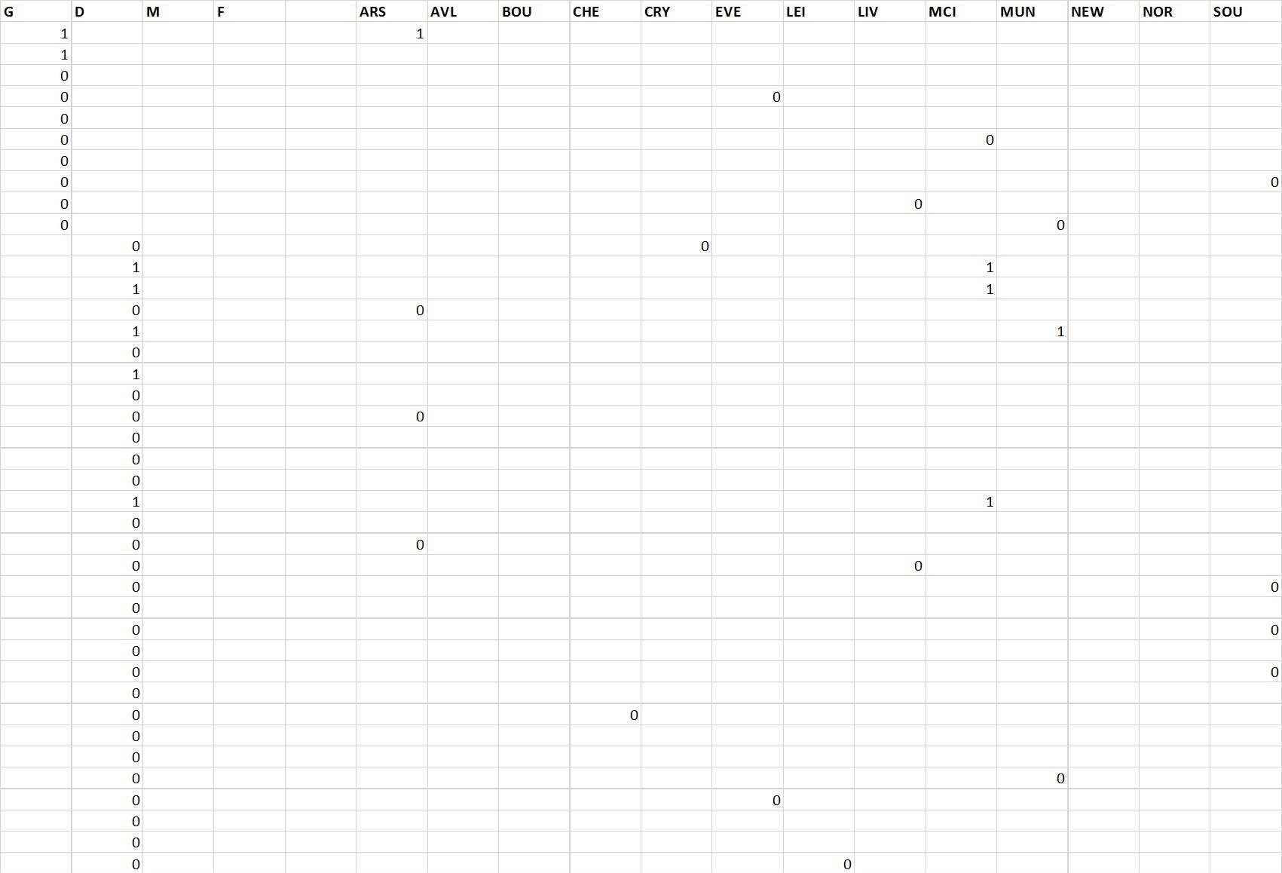
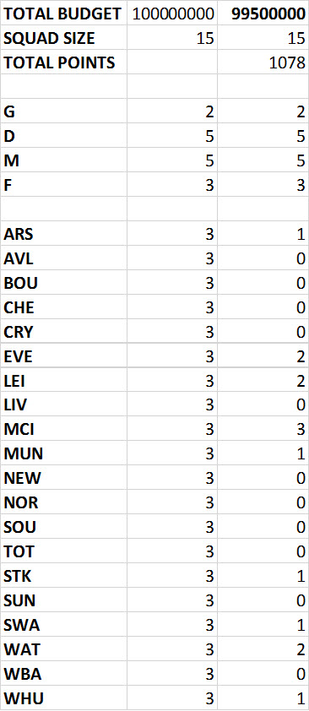
METHODOLOGY

Slide 16
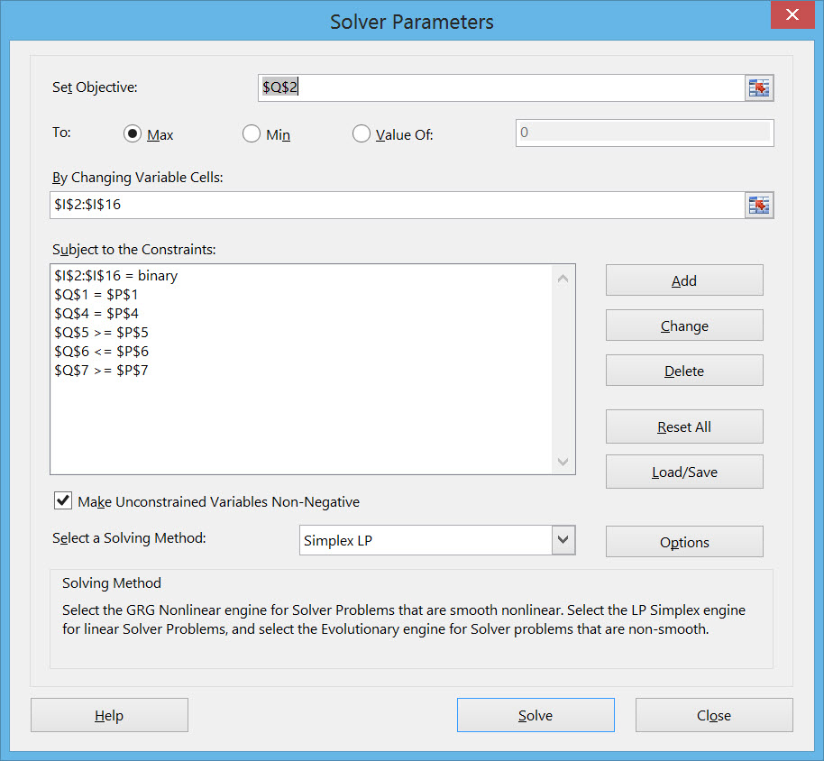
METHODOLOGY
Using Excel Solver:

Slide 17
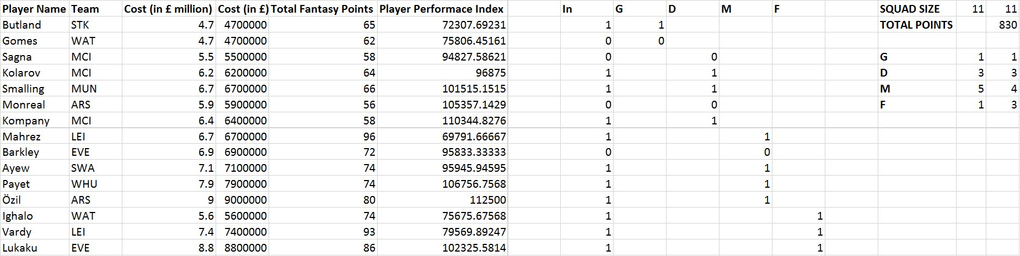
RESULTS

Slide 18
RESULTS: FINAL STARTING 11
Starting 11 Players
Butland Stoke City
Kolarov Manchester City
Smalling Manchester United
Kompany Manchester City
Mahrez Leicester City
Ayew Swansea City
Payet West Ham Utd
Özil Arsenal FC
Ighalo Watford FC
Vardy Leicester City
Lukaku Everton FC
Formation
1 Goalkeeper
3 Defenders
4 Midfielders
3 Forwards
Total Points Earned
830 Points
Total Budget Used
£99.5 Million

Slide 19
CONCLUSION
The final optimized Starting 11 players of the Fantasy Barclays Premier league successfully met all of the league rules.
The fantasy starting lineup optimization has to be done on a weekly basis, eliminating any injured or suspended players.

Slide 20


